Slide 1

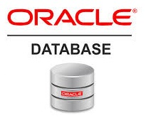
Oracle database
Lecture 1

Slide 2

Today’s Agenda
Pre-requisites For This Course
What Is Oracle ?
What Is An OORDBMS?
History Of Oracle
Editions Of Oracle
Course Outline

Slide 3
What You Should Know ?
To start learning Oracle , there is no strict pre-requisite
No specific programming language knowledge is needed.
Just basic knowledge in any programming language is more than sufficient

Slide 4
What Is Oracle?
Oracle is an OORDBMS
The term OORDBMS stands for:
Object
Oriented
Relational
Database
Management
System

Slide 5
What Is Oracle?
To fully understand the above full-form , we must break it into smaller parts and try to understand every part separately.
These are :
Data
Database
Database Management System
Relational DBMS
Object Oriented RDBMS

Slide 6
What Is Data?
Any kind of facts or information is called as Data.
For example:
Your name, your age , the population of a country , names of political parties in our country , today’s temperature etc
A picture , image , file , pdf etc can also be considered data.

Slide 7
From Where Data Is Generated ?
Every kind of data is generated by all the businesses around the world.
For example , consider a SOFTWARE TRAINING INSTITUTE like ours i.e. Sharma Computer Academy.
It is a business and has many constituent ENTITIES and their ACTIVITIES

Slide 8
From Where Data Is Generated ?
Can you tell what are the objects/entities connected to Sharma Computer Academy or any other training institute ?
Broadly speaking there are 4 main entities :
Employees→which can be further divided into Faculties and non technical staff
Courses→ The subject domains in which training is offered.
Batches → The classes conducted
Students→ who join these courses and their respective batches

Slide 9
From Where Data Is Generated ?
Each of these entities will have their own data.
For example:
Faculties→id , name , designation , salary, subject
Non-Technical Staff →id , name , designation, salary, job
Courses→ course name, course price, course syllabus,duration
Batches→ batchid, course, schedule,faculty .
Students→ name, contact details ,course opted, batch joined, fee paid

Slide 10
Why Data Is Important ?
Now for smooth functioning of any business or for taking future decisions on any business the DATA GENERATED BY ENTITIES IS VERY-VERY IMPORTANT.
For example:
What courses were offered online during lockdown ?
How many students opted these courses ?
Which was the most popular course ?

Slide 11
Why Data Is Important ?
If you think seriously all the previous questions are very important for a training institute business and they can only be answered if we properly store the data.
This is where a DATABASE comes into picture.

Slide 12
What Is A Database ?
A Database is a collection of inter-related data or information that is organized so that it can easily be accessed, managed, and updated .
So in our example a Database will be a collection/storage of all the facts related to all the business entities.
Like storing details about Faculties, details about Courses, details about Students etc

Slide 13
What Is A Database ?
Few more examples.
E-commerce companies like Amazon use Database to store product details , customer details , billing details , employee details etc
Let's also consider the Facebook. It also needs to store, manipulate and present data related to members, their friends, member activities, messages, advertisements and lot more. Here also database is used

Slide 14
How Databases Store The Data ?
Most of the databases store their data in the form of tables also called as relations.
Each table in a database has one or more columns, and each column is assigned a specific data type, such as number, a sequence of characters (for text), or a date.
Each row in the table has a value for each column.

Slide 15
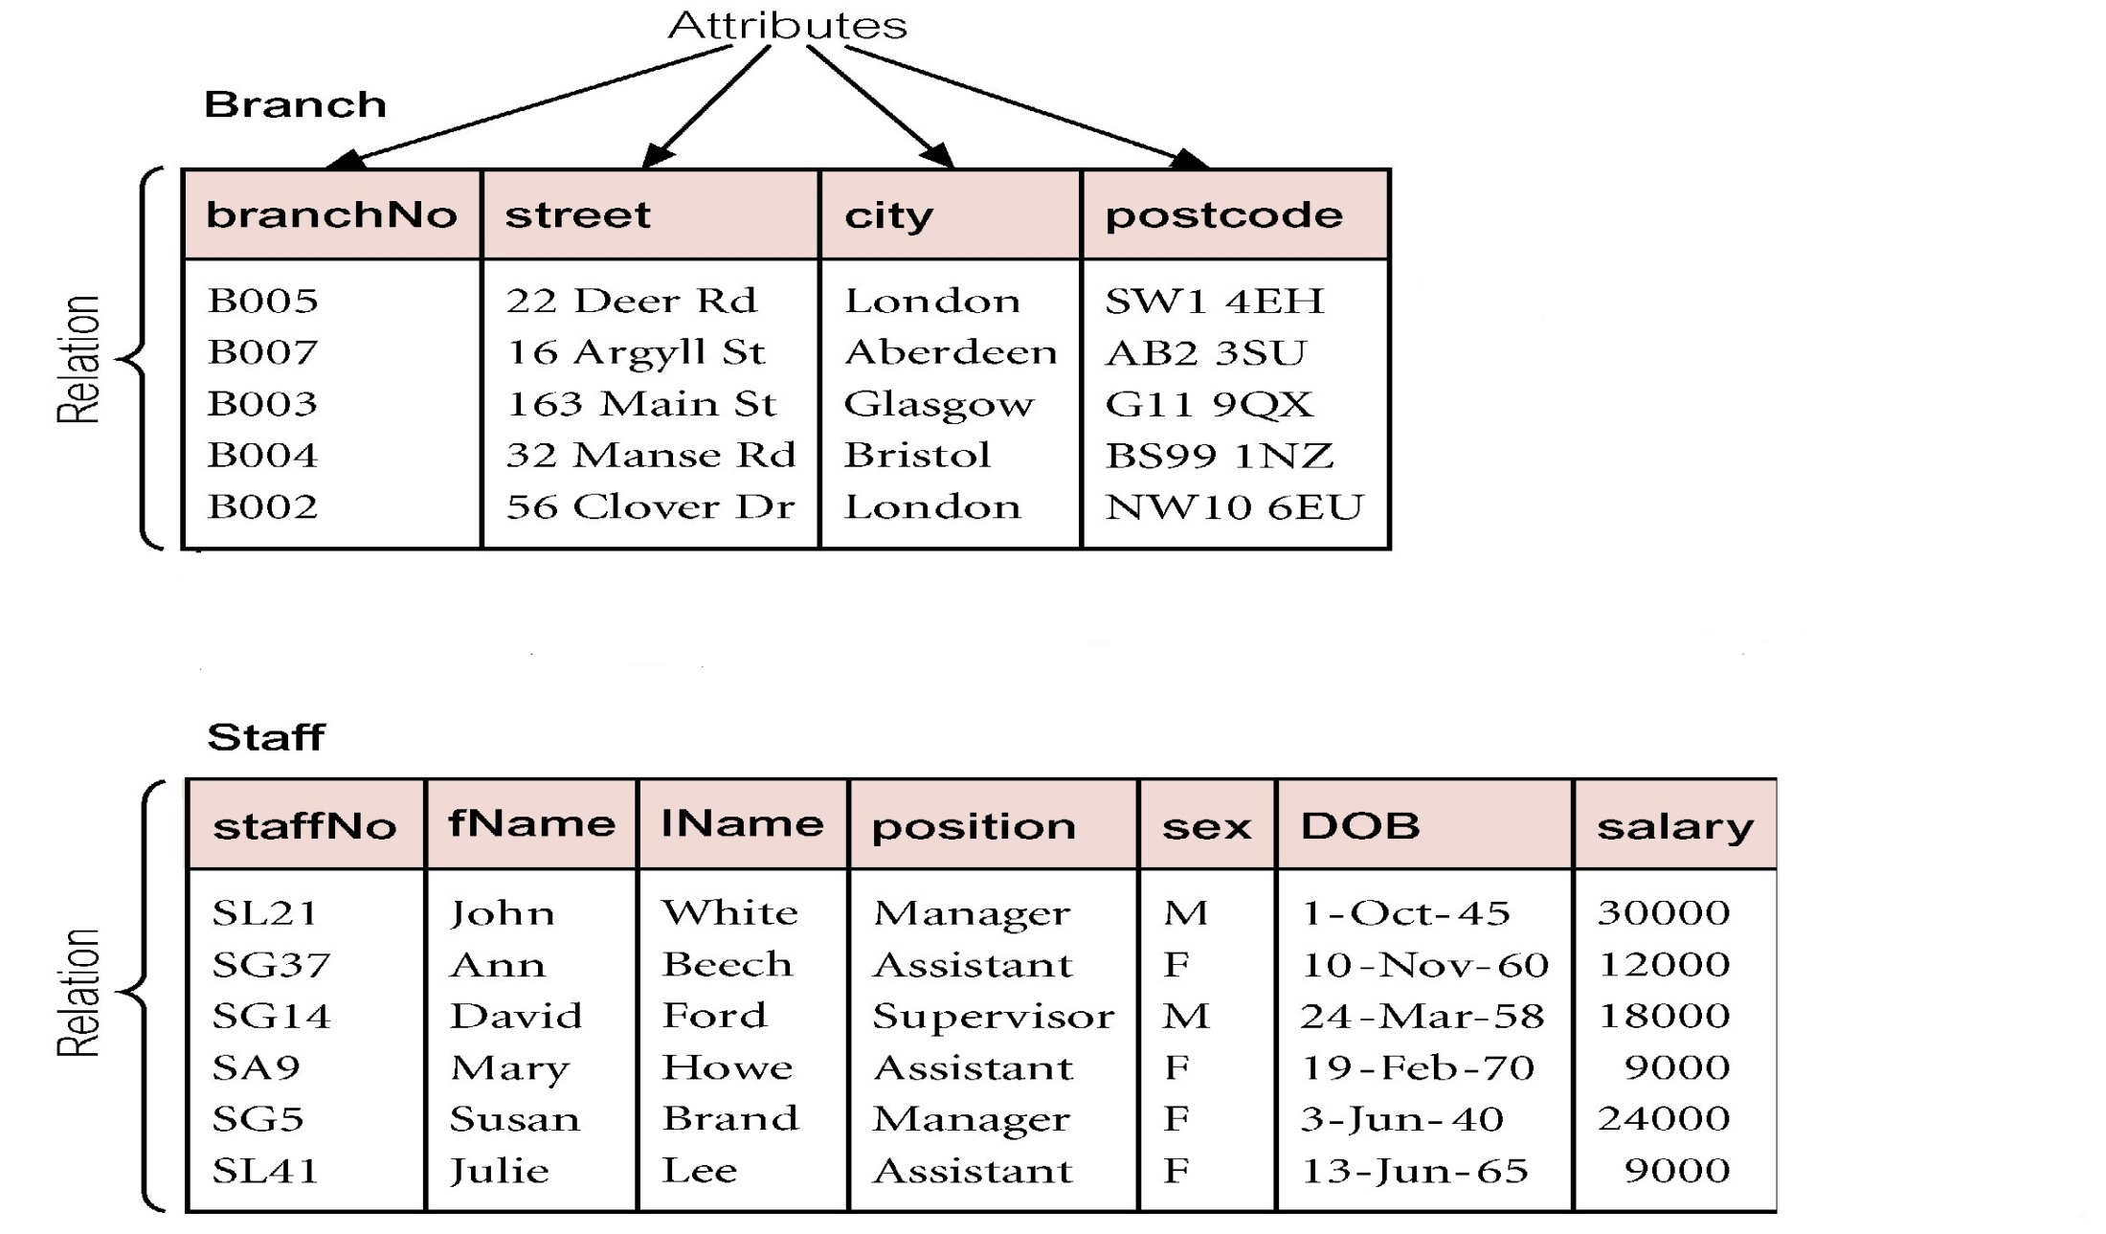
How Databases Store The Data ?

Slide 16
What Is A Relational Database ?
To understand what is a Relational Database , try answering the following questions considering the 2 tables , Branch and Staff shown previously.
Can you name the staff members working in London ?
Can you name the branch having maximum number of staff ?
Which branch pays the highest salary ?
Unfortunately we cannot answer because the tables Branch and Staff have no relationships defined between them

Slide 17
What Is A Relational Database ?
The solutions to all the above problems is a Relational Database.
A Relational Database organizes data into tables which can be linked—or related—based on data common to each.
This capability enables us to retrieve information , from the data in one or more tables with a single command.

Slide 18
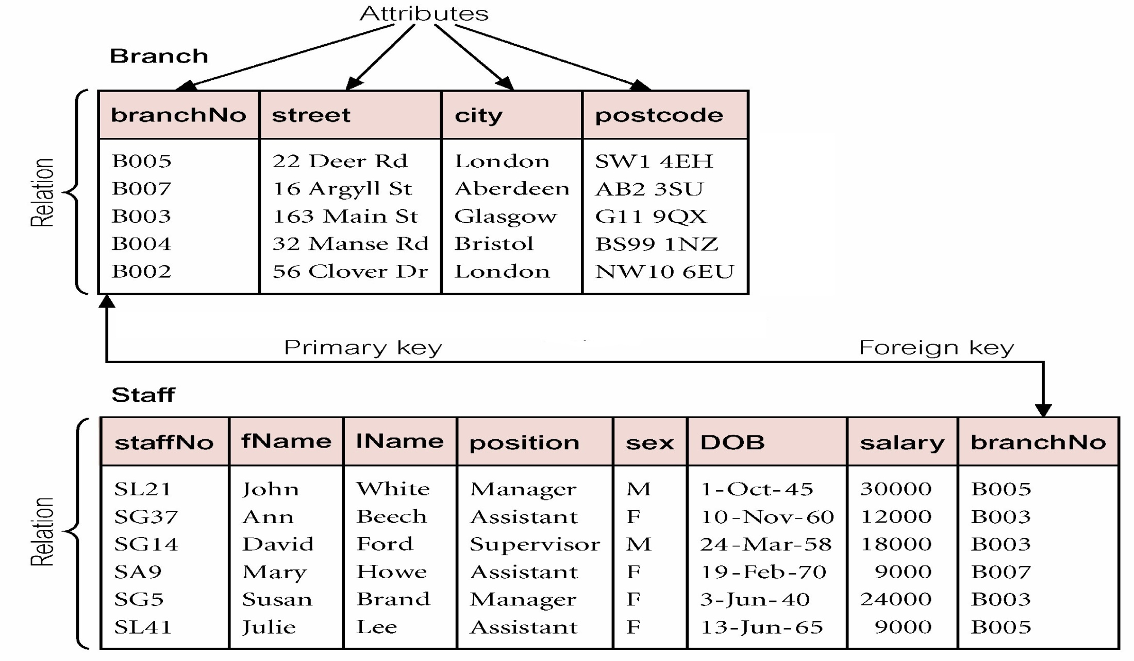
What Is A Relational Database ?

Slide 19
What Is A DBMS/RDBMS ?
An RDBMS is a program or a software that allows users to perform different operations on a database.
These operations include:
Creating the database/tables
Inserting records into these tables
Selecting records from these tables for displaying
Updating / Deleting the records

Slide 20
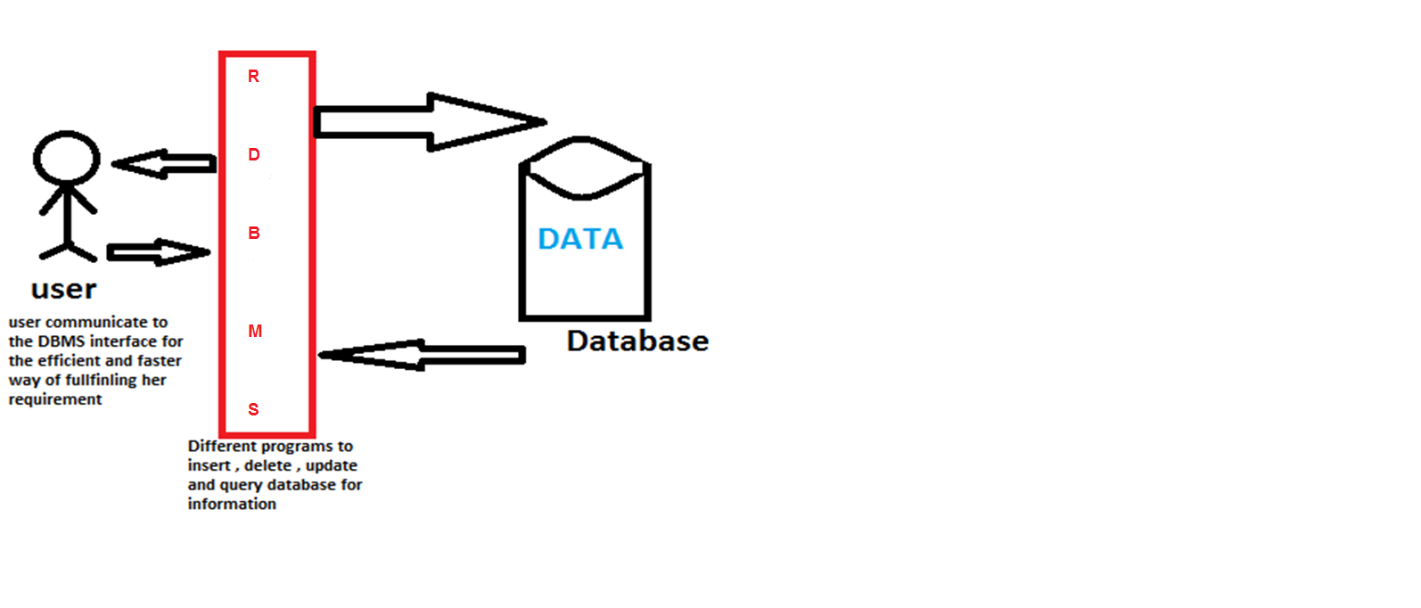
What Is A DBMS/RDBMS ?

Slide 21
Some Popular RDBMS
Some of the most popular RDBMS are:
Oracle
MySQL
MS SQL Server
SQLite
PostgreSQL
DB2
and many more

Slide 22
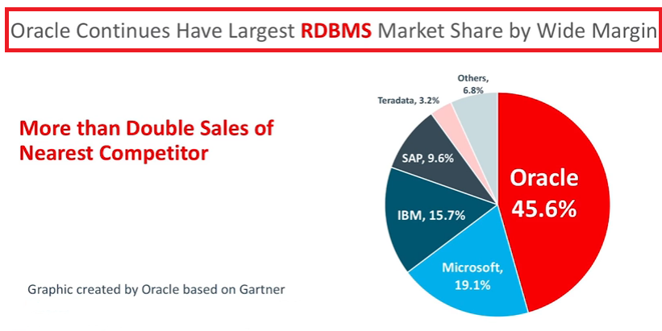
The Market Leader

Slide 23
What Is OORDBMS ?
The term OO stands for Object Oriented which means that the RDBMS supports the concepts of Object Oriented Programming also.
Oracle has this feature as it allows us to store data in the form of objects and also allows us to apply Object Oriented Concepts like Encapsulation , Polymorphism , Abstraction while maintaining the database.

Slide 24

History Of Oracle
Started by Larry Ellison in the year 1977 by the name of SDL i.e. Software Development Laboratories

Slide 25
History Of Oracle
After getting inspired by RDBMS concept the company started developing Oracle v 1.0 in Assembly Language but never released it publicly.
In 1979 , Oracle v 2.0 was released and the company changed it’s name to RSI ( Relational Software Incorporation).

Slide 26
History Of Oracle
In 1982 ,the company renamed itself to Oracle Corp.
In 1983 , Oracle v 3.0 was released which was completely rewritten using C programming language.
Then many versions of Oracle came but the biggest revolution was Oracle 8i which was launched in 1999 and supported Internet applications.

Slide 27
History Of Oracle
Then Oracle 9i was launched in the year 2001
In 2003 , Oracle 10 g was launched where g stands for a concept called grid computing
In 2007 , Oracle 11 g was launched which supported OLTP and OLAP.

Slide 28
History Of Oracle
In 2014 , Oracle 12 C was launched where C means Cloud Computing
In 2018 , Oracle 18 C is launched which is worlds first autonomous database
Finally in 2019 , Oracle 19 C was launched which is the current latest version of Oracle as of now.

Slide 29
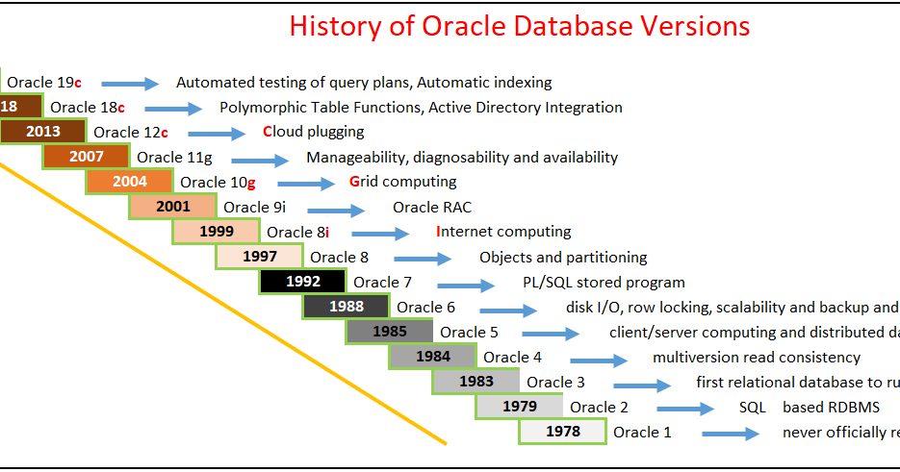
History Of Oracle

Slide 30
Editions Of Oracle
Oracle Database is available in five editions, but three editions amongst them are more common and popular.
These are:
Oracle Enterprise Edition
Oracle Standard Edition
Oracle Express Edition
For learning purpose all are free to download but for commercial use first 2 are paid while 3rd one in free for commercial use also

Slide 31
Editions Of Oracle
Oracle Enterprise Edition (EE) is the most expensive edition of the Oracle Database and has the following characteristics:
No maximum number of CPUs
No limits on memory or database size
Include premium features that are not available in other editions.

Slide 32
Editions Of Oracle
Oracle Standard Edition (SE) is a limited edition of the Enterprise Edition that has the following characteristics:
Limited to four or fewer CPUs
No limit on memory or database size
Include many features, but no as many as EE

Slide 33
Editions Of Oracle
Oracle Express Edition (XE) is a free-to-use version of the Oracle Database but it is not available for every version. These are the features of Oracle Database XE 18c:
Limited to 2 CPUs
Can use the maximum of 2GB of RAM, and has 12GB of user data.
Very limited features

Slide 34
Course Outline
We will be covering complete SQL and PL-SQL in this course.
Course Duration : Around 45 hours
Class Timings: 5:15 PM to 6:15 PM ( M,W,F)
SQL | PL-SQL
Commands like DDL,DML,DCL,TCL,DQL | Writing PLSQL Scripts | Exception Handling
Data types & Operators | Control Statements | Stored Procedures
Clauses | Loop | Stored Functions
Joins & SubQueries | Case Structure | Packages
Constraints | Cursor | Triggers
Views & Sequences | Cursor For Loop

Slide 35

Course Fee

